Slide 1






SMART CAMPUS
UNIFIED ERP SYSTEM
TEAM NAME: DELTA
PRESENTED BY:
DEEP DAS
TRIDEEP RAY
SANGITA GHOSH
COLLEGE NAME:
ST. XAVIER’S COLLEGE, BURDWAN
SELECTED PROBLEM:
CAMPUS MAINTENANCE & ISSUE TRACKING SYSTEM

Slide 2



PROBLEM UNDERSTANDING
CHALLENGES IN TRADITIONAL CAMPUS SYSTEMS
Issue reporting is mostly manual and unstructured
Students have no way to track issue status
Administrators lack a centralized monitoring system
Delayed resolution leads to poor campus experience
No transparency or accountability
WHY THIS IS A PROBLEM
Wastes time and resources
Reduces student satisfaction
Creates communication gaps between students and administration

Slide 3
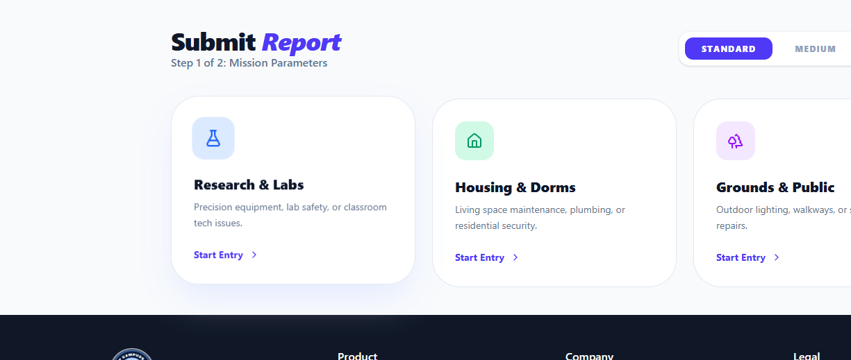
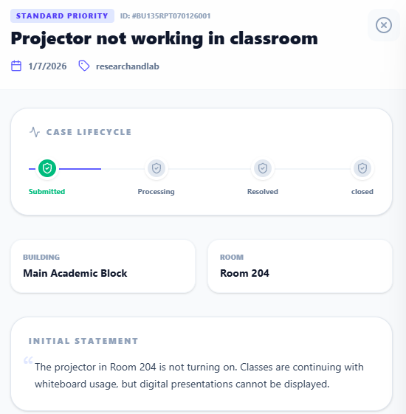
SOLUTION
OVERVIEW
OUR SOLUTION: SMART CAMPUS ISSUE TRACKING SYSTEM
A web-based platform for managing campus issues digitally
Allows students to report issues with title, description, and images
Provides real-time issue status:
Submitted → In Progress → Resolved
Enables administrators to track, manage, and resolve issues efficiently
Ensures secure access and role-based control
KEY BENEFITS
Faster issue resolution
Improved communication
Increased transparency and accountability

Slide 4
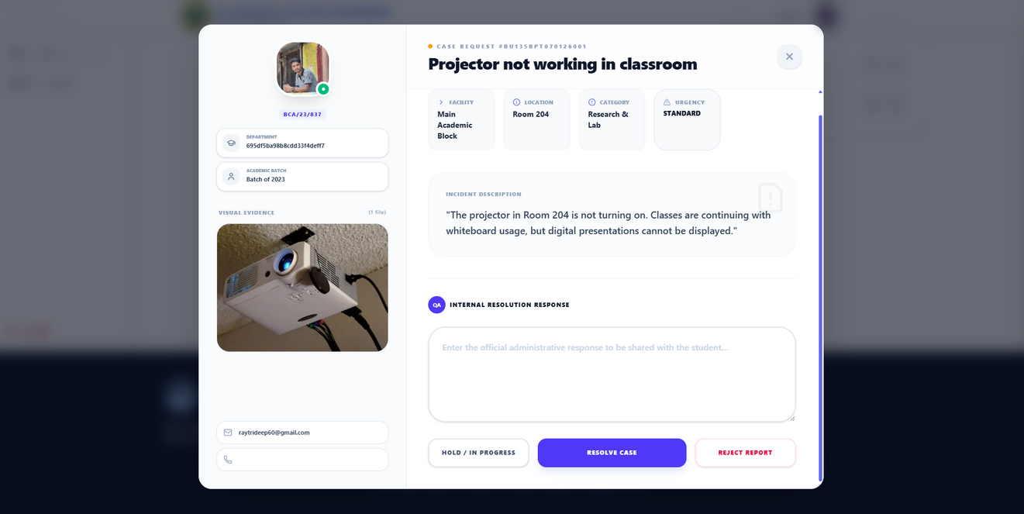
USER & ADMIN WORKFLOW
Student Workflow
Secure login
Report an issue (title, description, image)
Submit issue
Track status updates
Receive resolution confirmation
Give ratings
Admin Workflow
Secure login
View all reported issues
Analyze issue details
Update issue status
Resolve and close the issue

Slide 5
SYSTEM ARCHITECTURE
Frontend Layer
React + Vite → Fast, modern UI development
Tailwind CSS → Responsive design
Framer Motion → Animations & UX
Recharts → Visual analytics & charts
Axios → API communication
QR Tools & jsPDF → QR generation & report export
Hot Toast → Live user notifications
Frontend (React + Vite + Tailwind)
Backend Layer
Backend API (Node.js + Express)
Node.js + Express → REST API server
JWT + Cookies → Authentication & sessions
MongoDB + Mongoose → Data management
Multer + Cloudinary → File & image uploads
Nodemailer → Email services
Razorpay → Secure payment processing
Authentication Layer (JWT, Cookies)
Database (MongoDB + Mongoose)
Cloud Services (Cloudinary, Email, Payments)

Slide 6
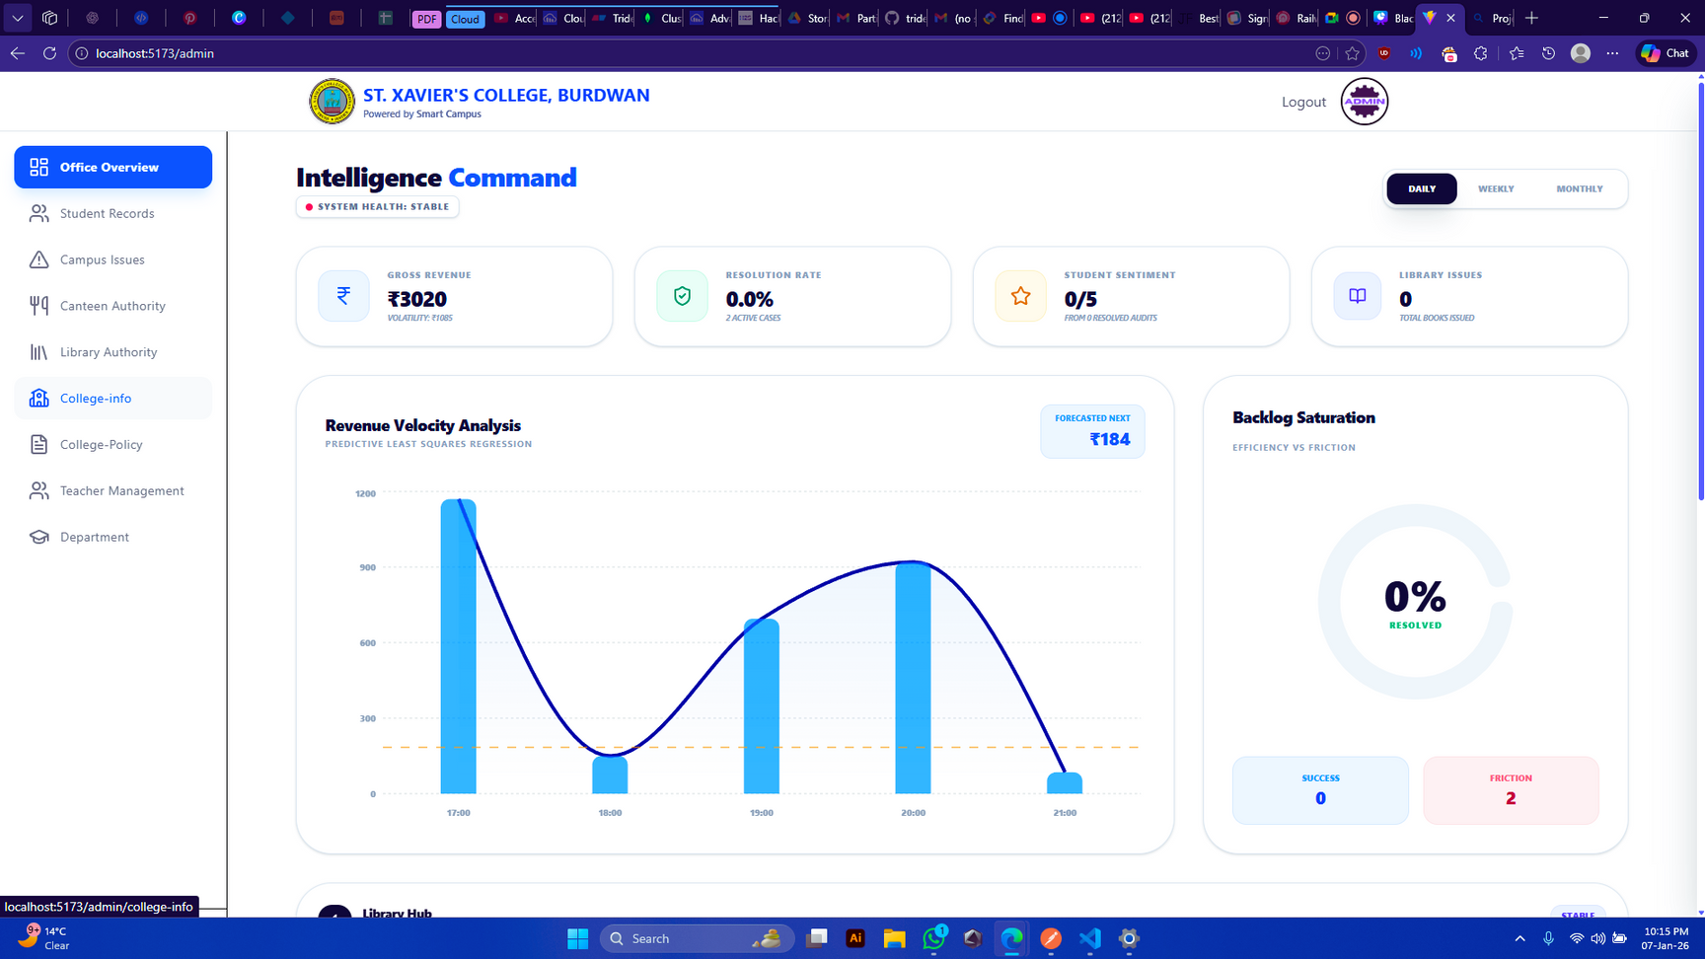

CORE FEATURES
STUDENT FEATURES
ADMIN FEATURES
Secure login
Report campus issues with title, description & image
Track real-time issue status
View issue history & updates
Receive email notifications
Secure admin authentication
Centralized issue dashboard
View, filter & manage reported issues
Update issue status: Open / In Progress / Resolved
Full visibility of campus operations
Role-based access control
Dynamic and Real-time UI feedback
Scalable & secure architecture

Slide 7


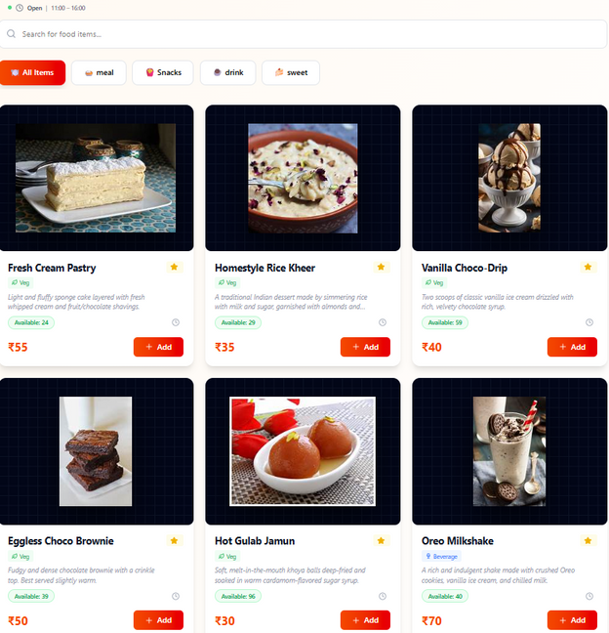
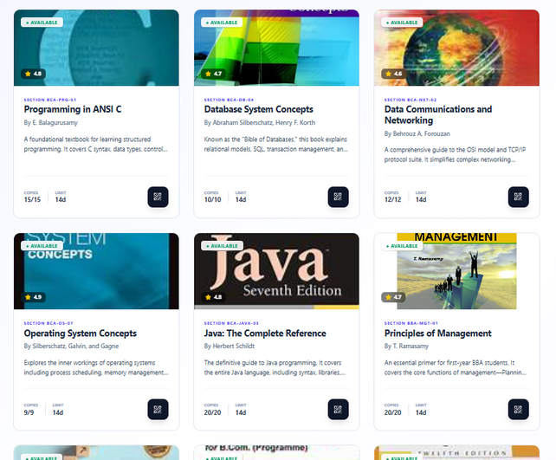



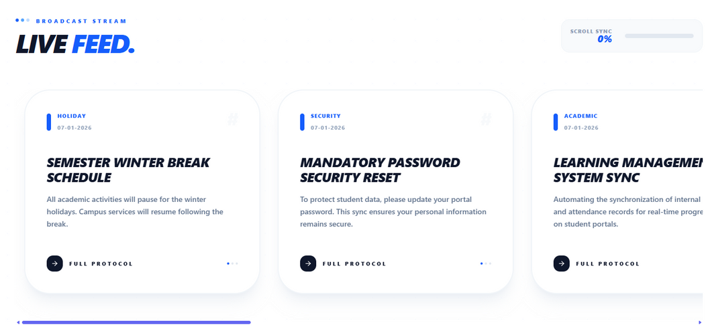
ADDITIONAL FEATURES
Canteen Management
Library Management
Online food ordering system
Secure online payments
Live order tracking for students & staff
Complete book catalog system
Book issue & return workflow
Student library profiles
Campus Engagement
Communication System
College Gallery for campus activities
Admin uploads images, students view updates
Admin publishes college notifications
Students receive real-time updates

Slide 8
TECHNOLOGY STACK
FRONTEND
BACKEND
SERVICES & TOOLS
React + Vite
Node.js
Cloudinary (Image Storage)
Tailwind CSS
Express.js
Nodemailer (Email Service)
Framer Motion
MongoDB
Razorpay (Payment Gateway)
Recharts
Mongoose
Multer (File Uploads)
Axios
JWT Authentication
dotenv
QR Tools
bcrypt Encryption
cookie-parser
jsPDF
Cookie
Cookie
Hot Toast
QR Code
cors

Slide 9
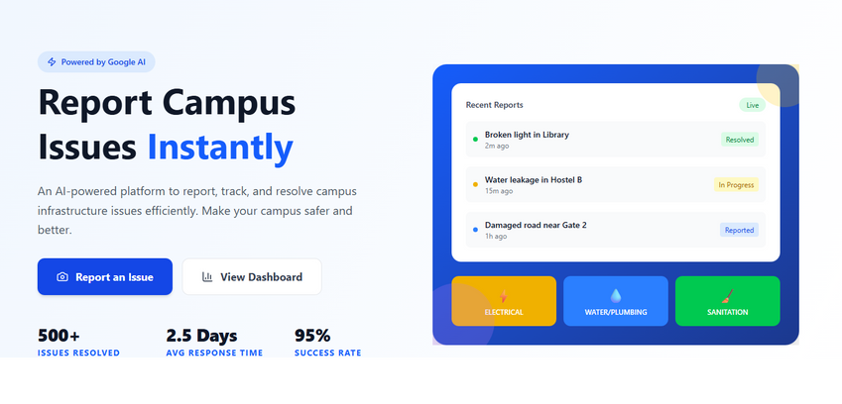
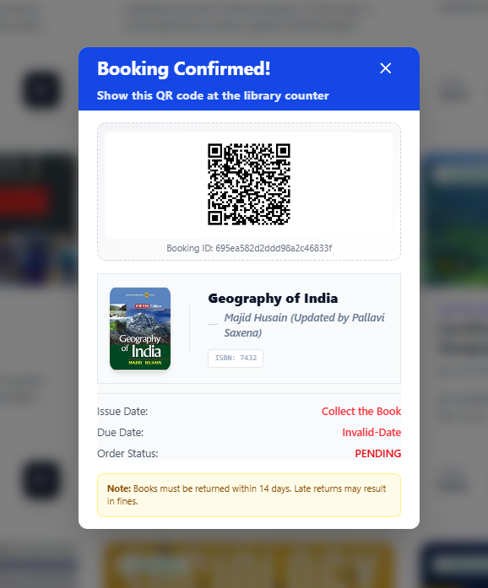
CONCLUSION & IMPACT
Project Impact
Digitizes critical campus operations
Reduces manual workload for administration
Improves communication between students and staff
Enhances transparency & accountability
Creates a scalable foundation for a fully digital campus
Why Smart Campus Matters
Smart Campus is not just a project — it is a complete digital transformation framework for educational institutions that modernizes campus operations, improves administrative efficiency, and enhances the overall student experience.
Our vision is to build a queue-less, paperless, and fully connected campus, where students and administrators can access essential services instantly without long waiting times or manual processes.
By integrating all core campus services into one intelligent platform, Smart Campus creates a transparent, efficient, and future-ready educational ecosystem.

Slide 10
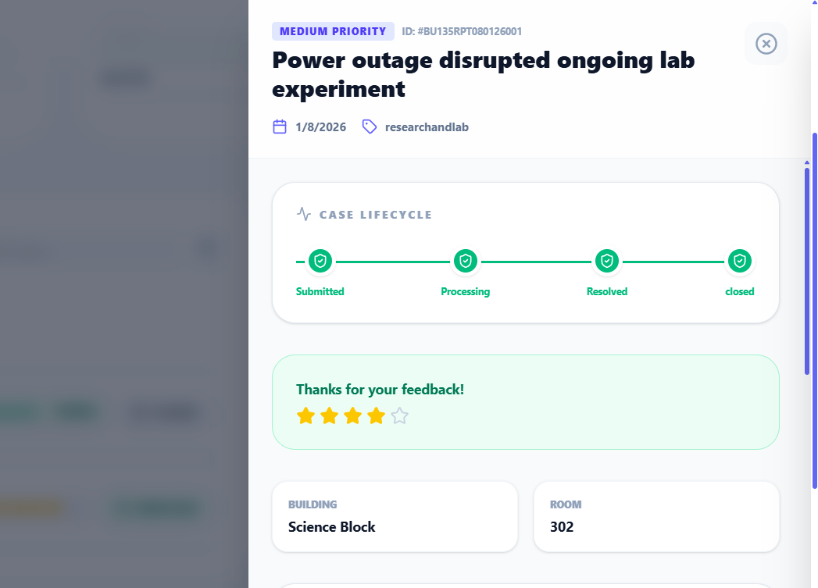
THANK YOU
TEAM NAME: DELTA

